Slide 1
AIM6140: Health Informatics
Health data analytics process

Slide 2
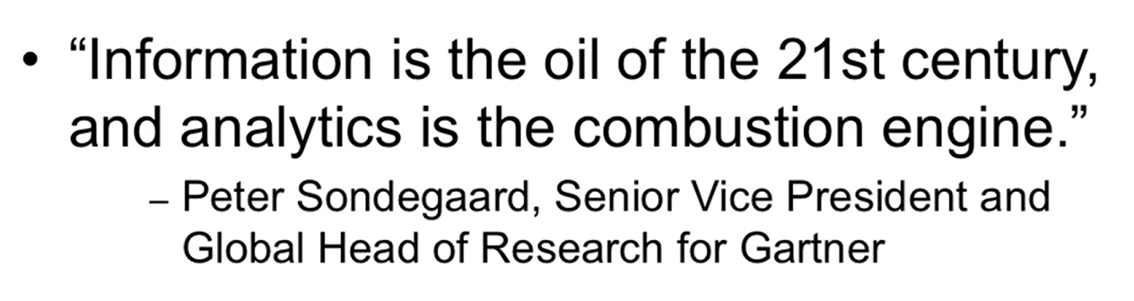
Information and Analytics

Slide 3
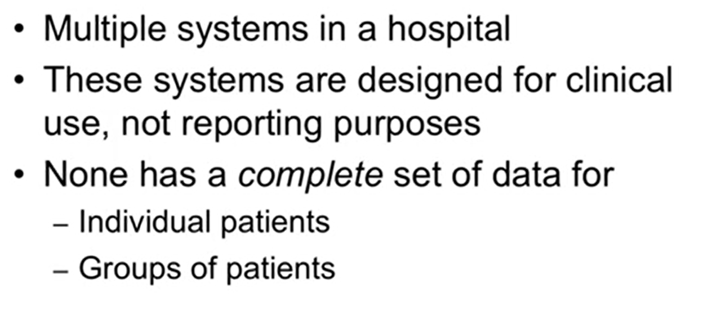
Patient Data in a hospital

Slide 4
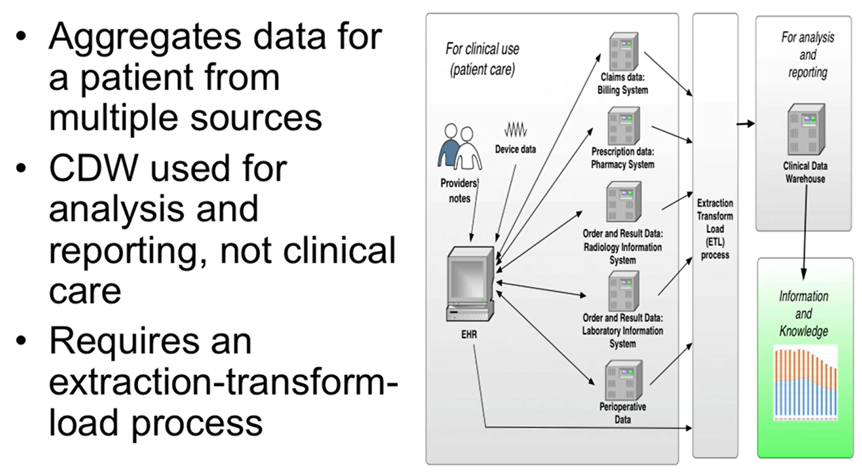
Clinical Datawarehouse (CDW)

Slide 5
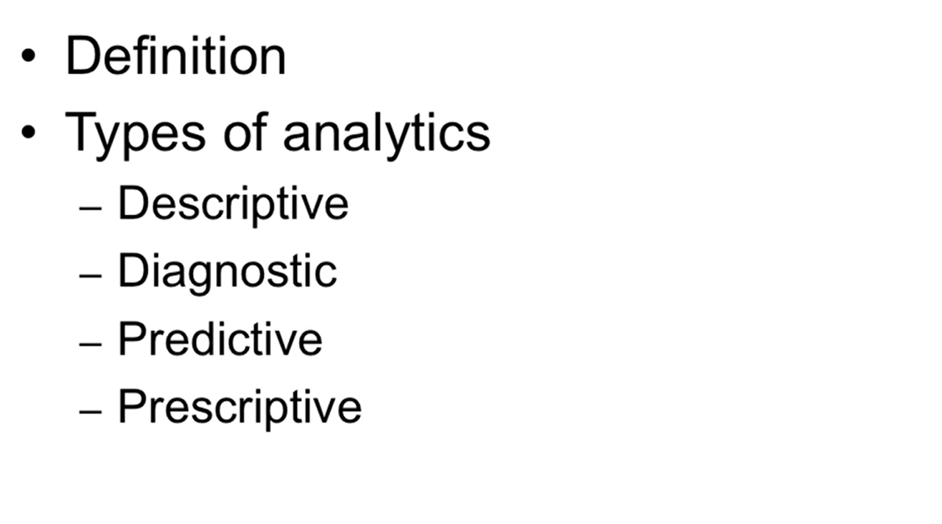
Analytics and its types

Slide 6
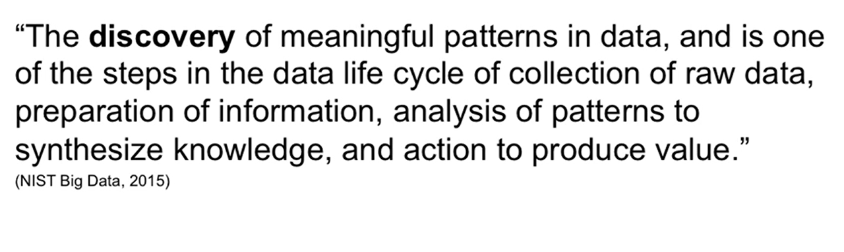
What is Analytics?

Slide 7
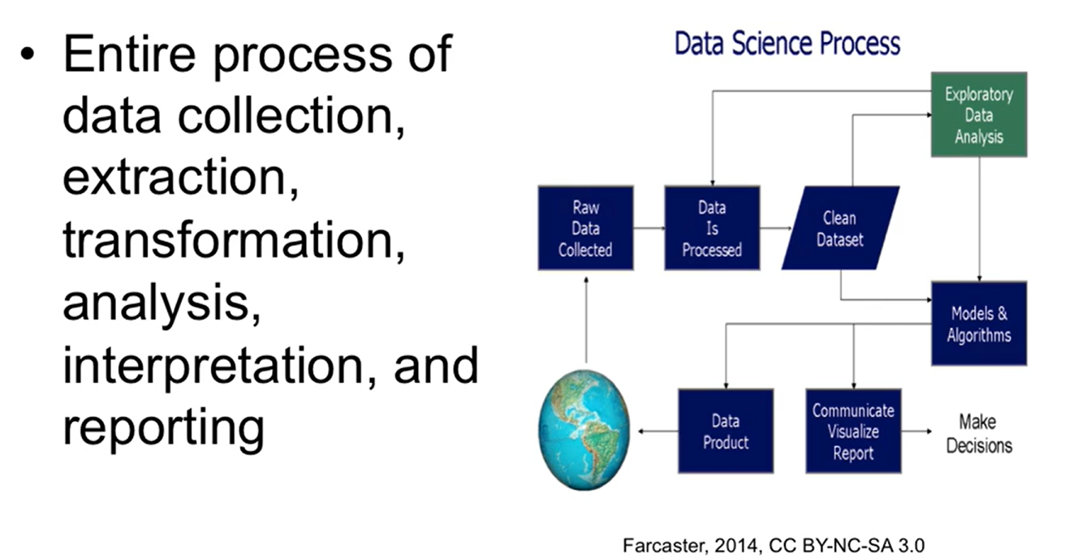
Contd…

Slide 8
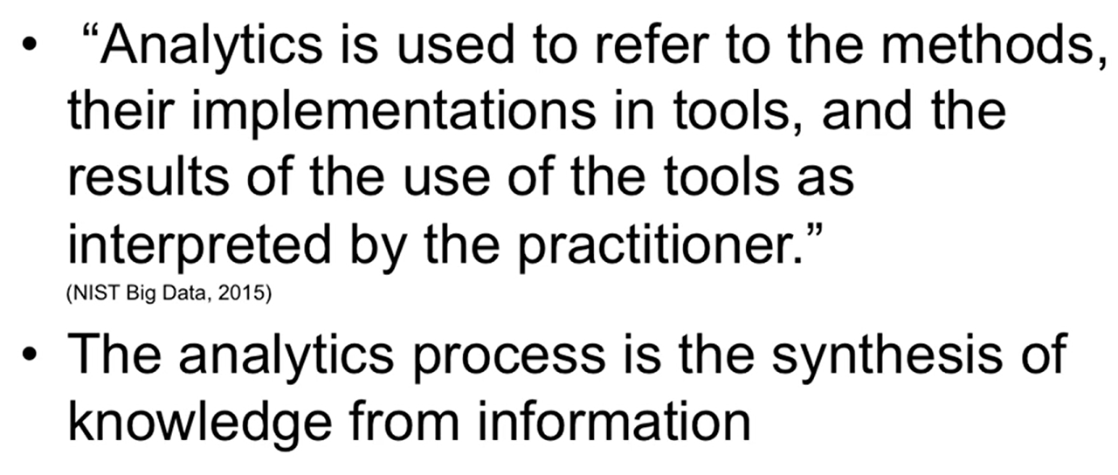
Contd…

Slide 9
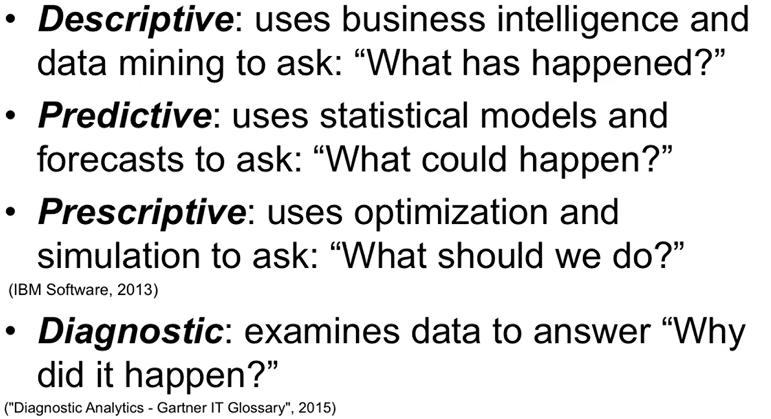
Types of Analytics

Slide 10
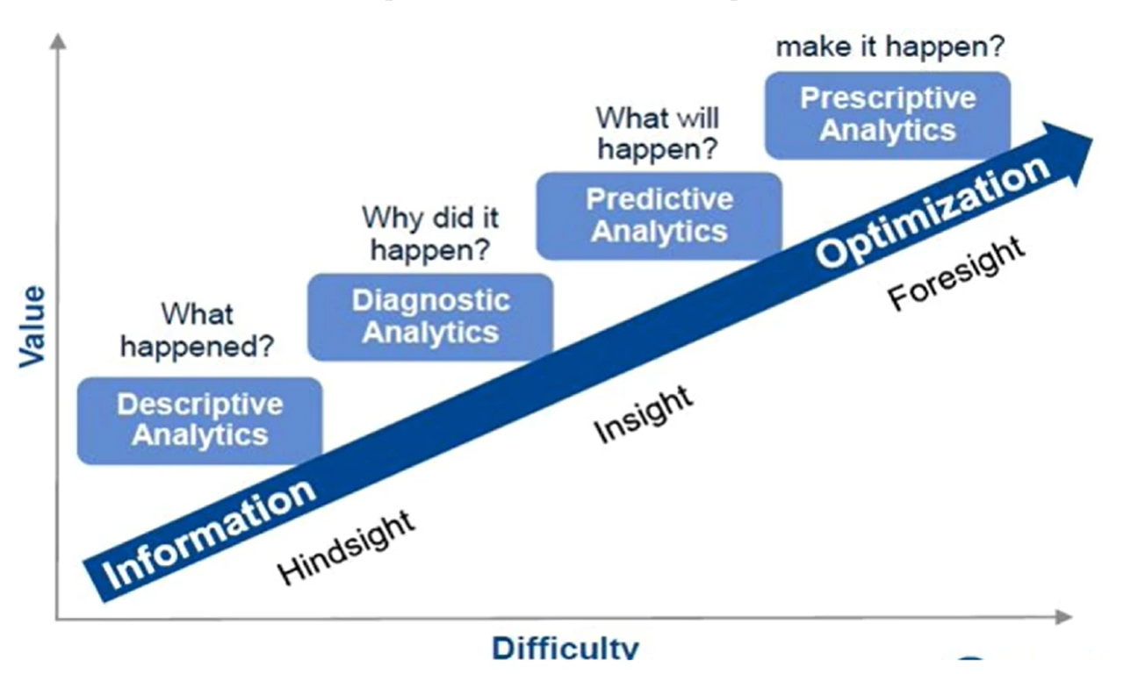
Types of Analytics contd…

Slide 11
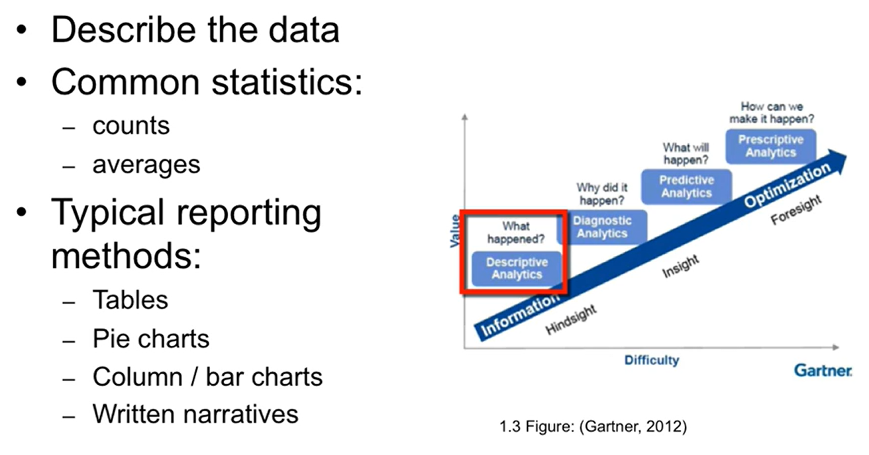
Types of Analytics contd…

Slide 12
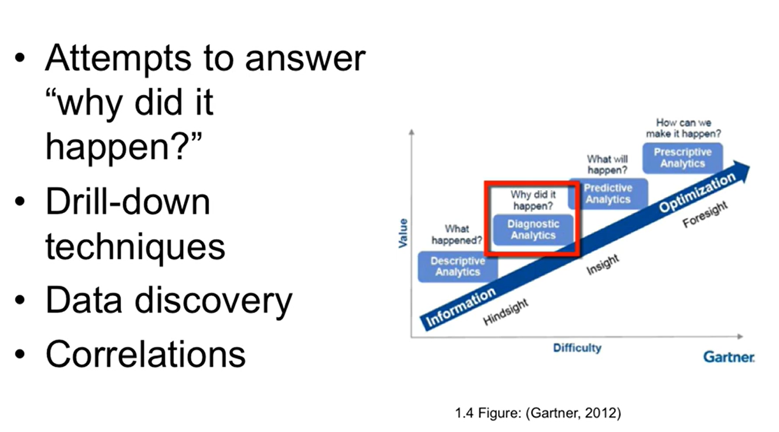
Types of Analytics contd…

Slide 13
An example
Kaiser Permanente analyzed data on infants to develop an algorithm for classifying which babies are at the risk for developing Sepsis and conversely which babies do not need to be treated for Sepsis at all. Sepsis is described by the Mayo Clinic as a potentially life-threatening complication of an infection when chemicals are released into the bloodstream and to fight it trigger inflammatory responses throughout the body and may trigger a cascade of changes that can affect multiple organs. It may cause them to fail if sepsis progresses to septic shock, blood pressure falls dramatically and lead to death. Kaiser Permanente stated that the judicious application of their scheme could result in decreased antibiotic treatment in 880,000 US newborns each year and is an example of application for predictive analytics.

Slide 14
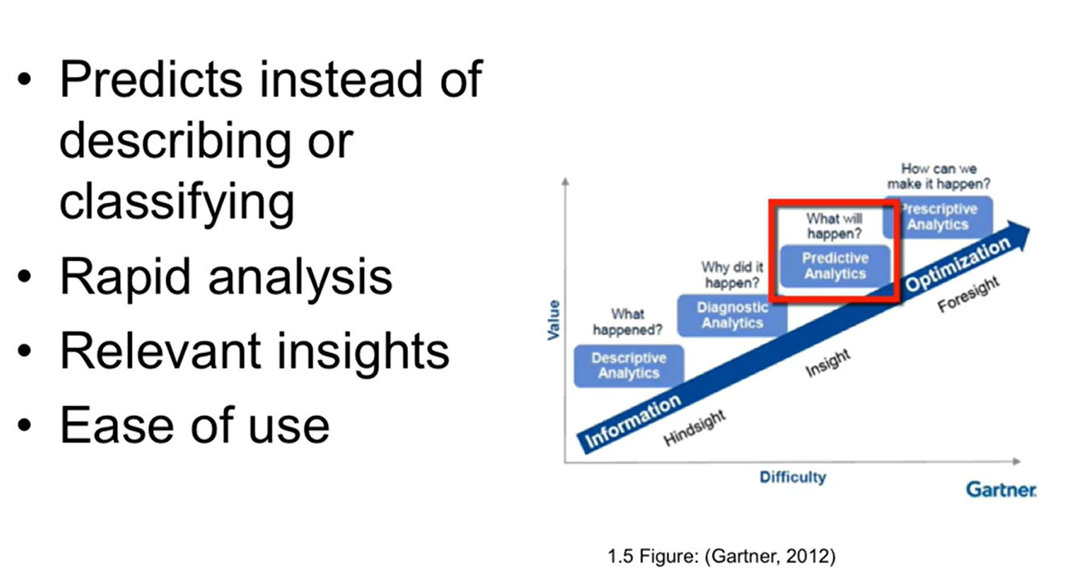
Types of Analytics contd…

Slide 15
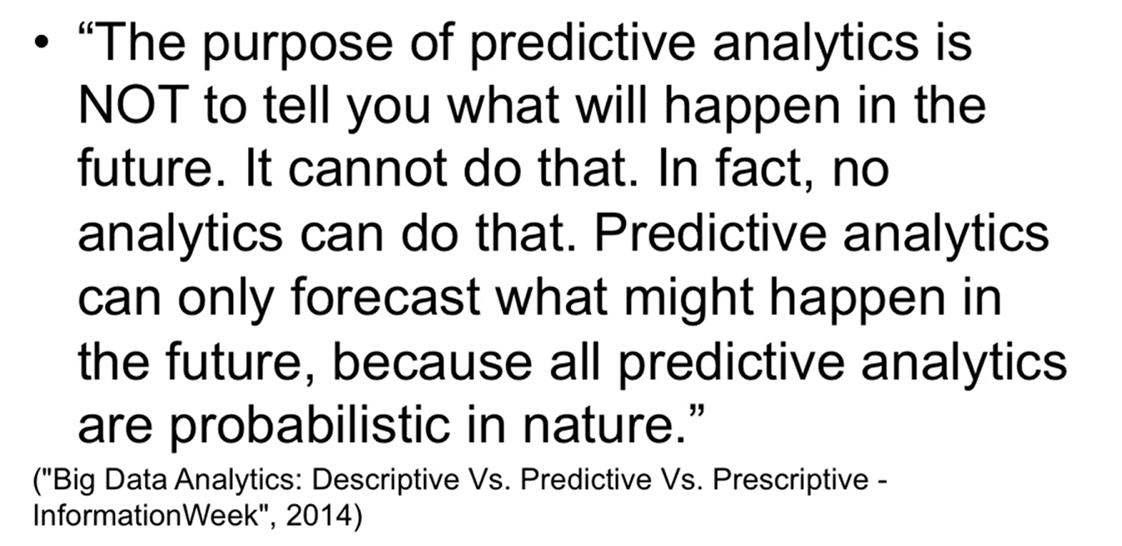
What Predictive Analytics cannot do?

Slide 16
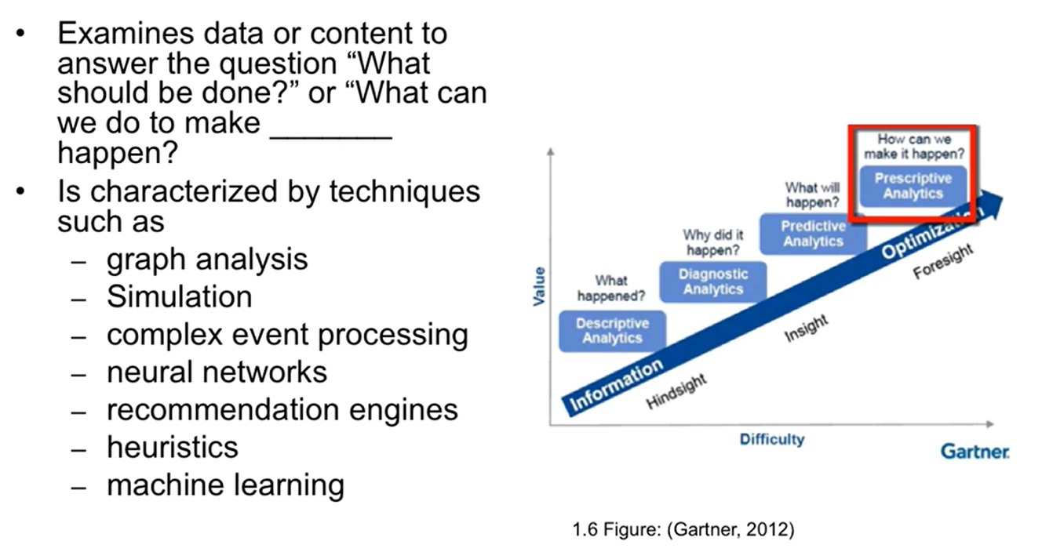
Types of Analytics contd…

Slide 17
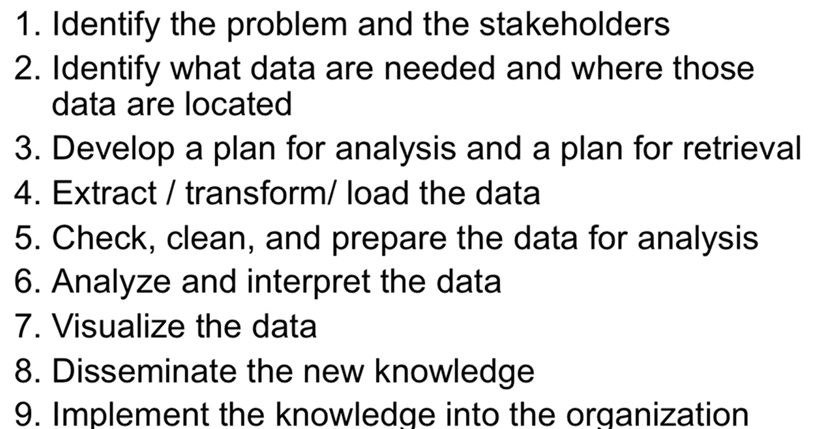
Steps in Data Analytics

Slide 18
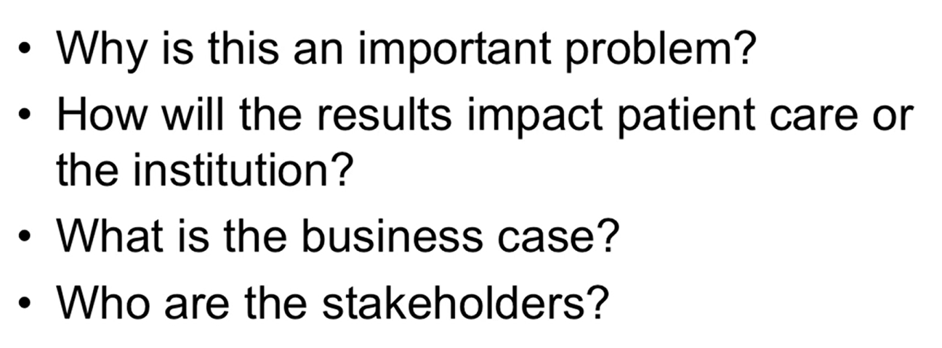
Identify Problem and stakeholders

Slide 19
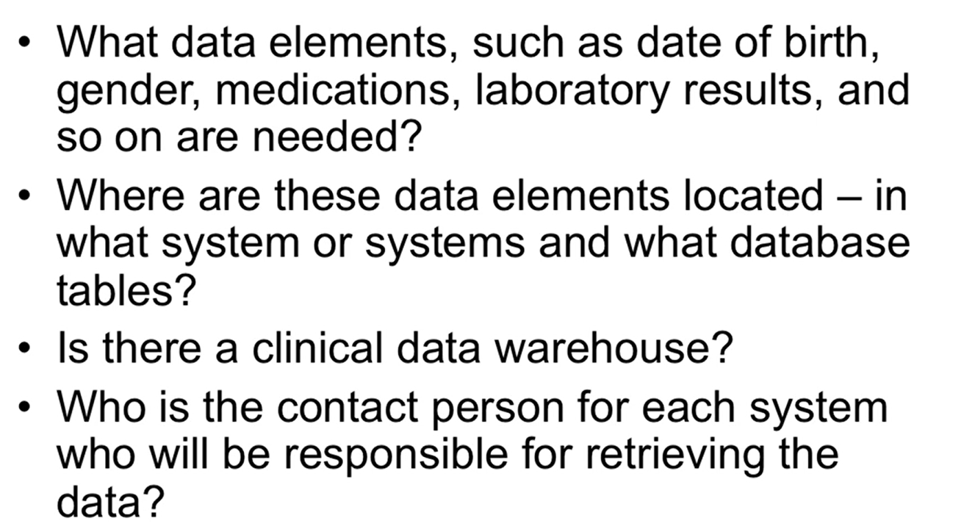
Identify what data are needed?

Slide 20
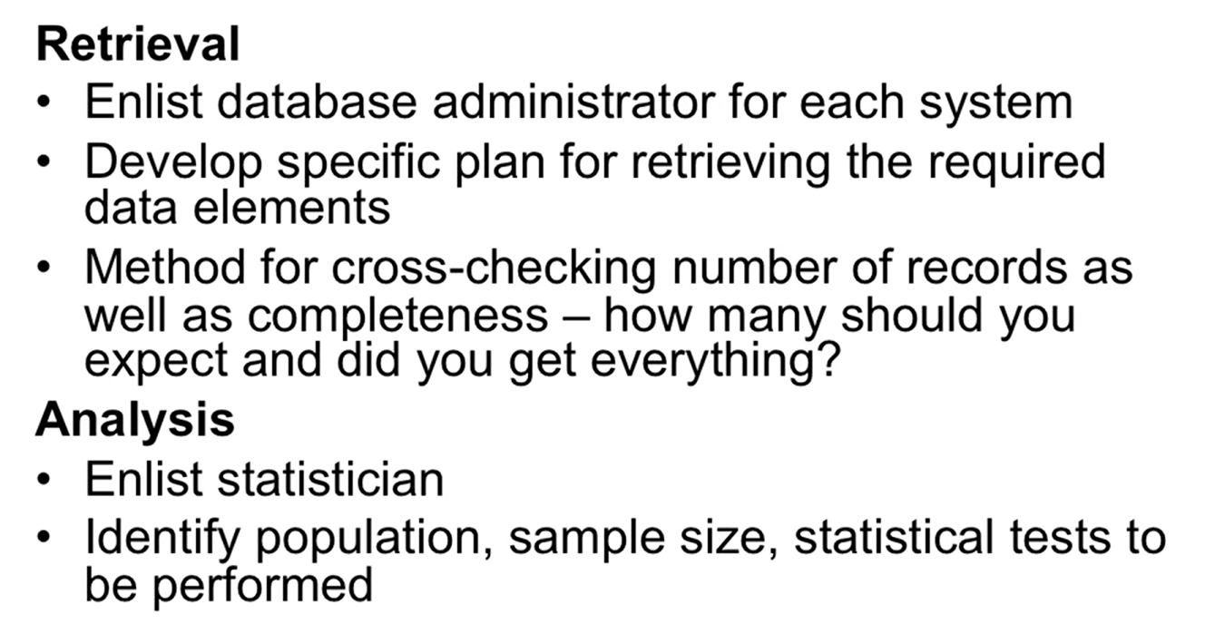
Plans for retrieval and analysis

Slide 21
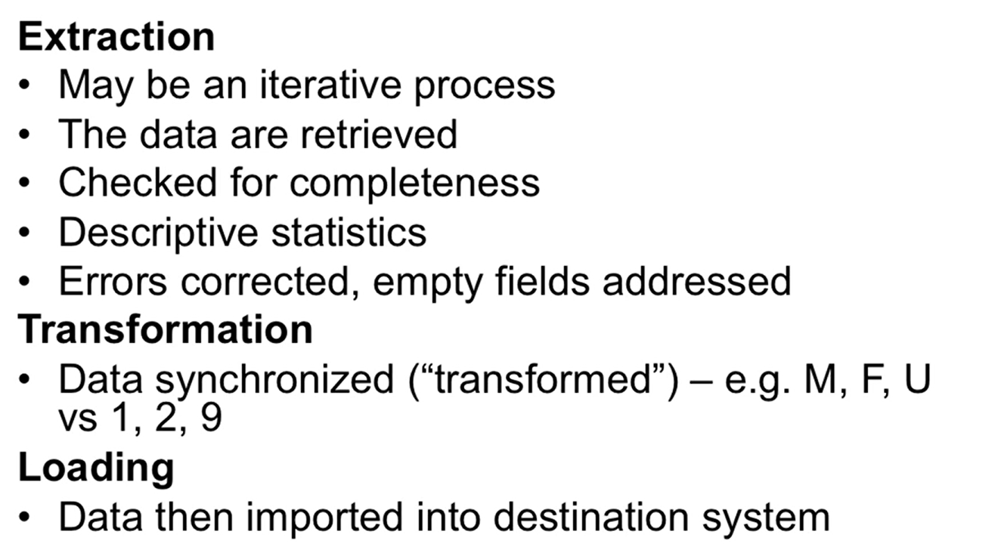
Extract, Transform and Load (ETL)

Slide 22
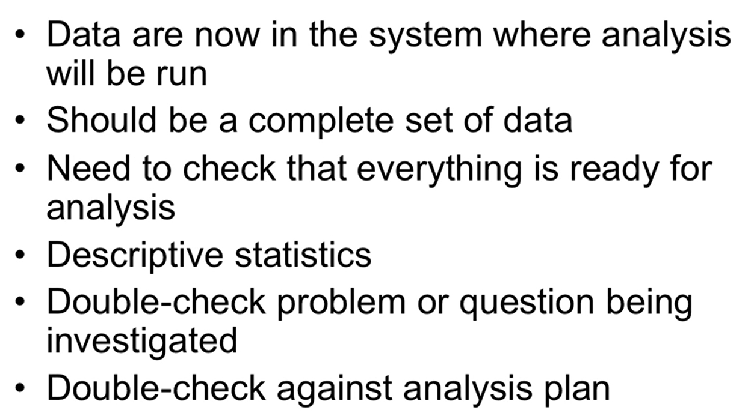
Check, clean and prepare data

Slide 23
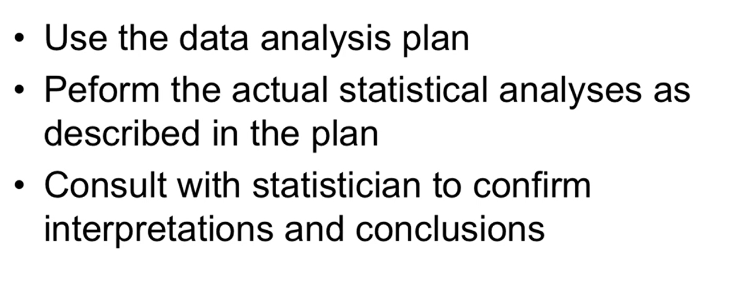
Analyze and interpret data

Slide 24
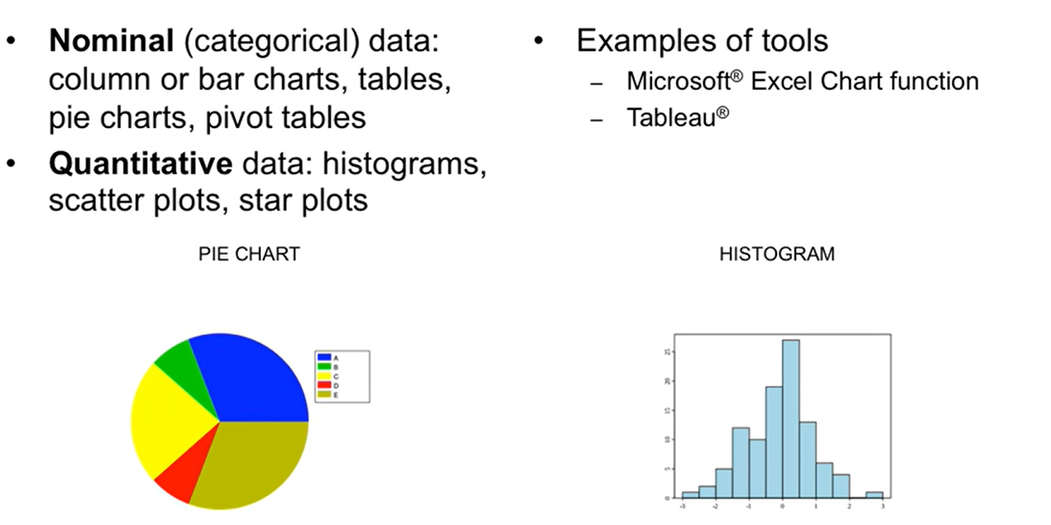
Visualization of data

Slide 25
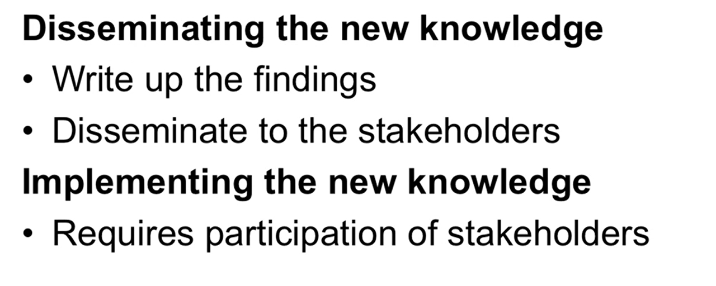
Dissemination and implementation of new knowledge

